Slide 1



Machine Learning Approach in ATLAS Particle Energy Calibrations
Adnan Alramadan, Ken Johns, Peter Loch,
Olivia Pitcl, Jad Sardain
University of Arizona
Space Grant Symposium, ASU, 22 April 2023

Slide 2
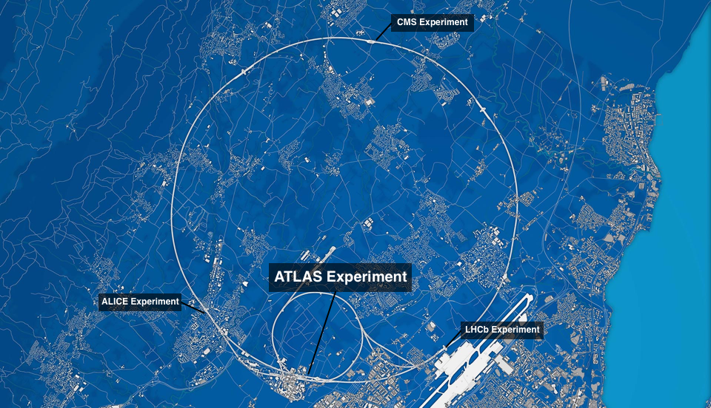
Background
                ATLAS is a particle detector experiment in Switzerland at CERN’s Large Hadron Collider (LHC)
                Proton-proton collisions are used to probe ensuing particle showers for new matter (i.e. dark matter and other beyond-the-Standard Model particles)
                Machine learning is used to optimize the performance of the detector
                atlas.cern

Slide 3
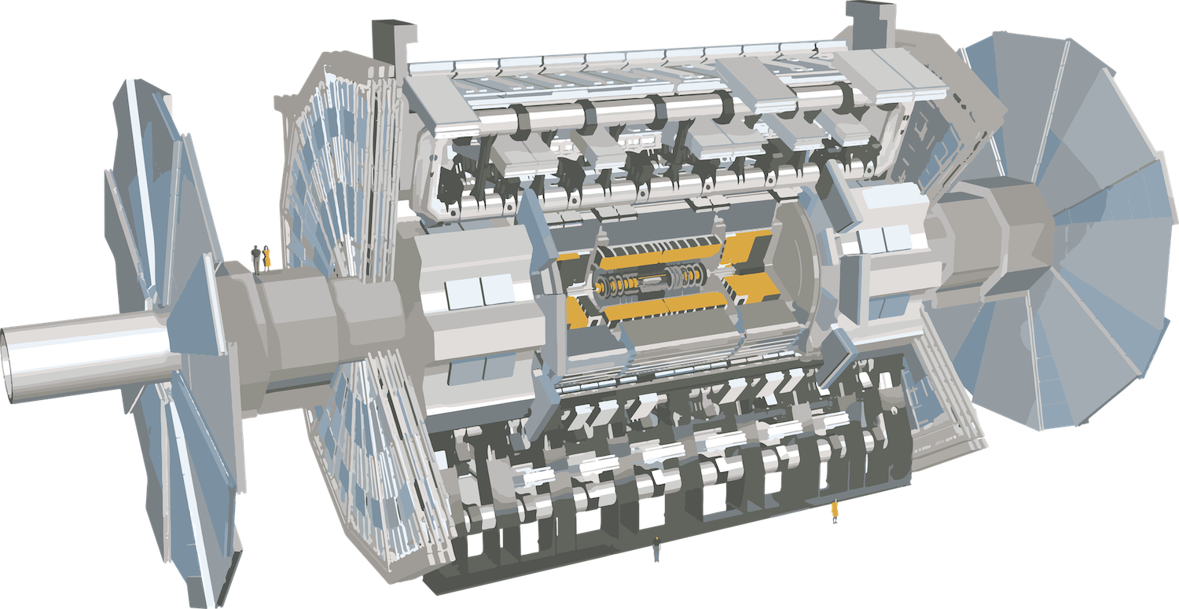
Background
                ATLAS is comprised of several layers designed to capture particles of differing types and energies
                Source: atlas.cern

Slide 4
Background
                ATLAS is comprised of several layers designed to capture particles of differing types and energies
                scale reference
                Source: atlas.cern

Slide 5
Background
                ATLAS is comprised of several layers designed to capture particles of differing types and energies
                muon spectrometer
                scale reference
                magnet system
                inner detector
                calorimeter
                Source: atlas.cern

Slide 6
Background
                ATLAS is comprised of several layers designed to capture particles of differing types and energies
                muon spectrometer
                scale reference
                magnet system
                inner detector
                calorimeter
                Source: atlas.cern

Slide 7
Background
                Hadronic calorimeter measures the energies of most particles produced in the collisions
                - clusters: energy deposits within the calorimeter
                - cluster energies detected are often not the true energies of the clusters
                - pileup: influx of particles from overlapping collisions (1 bill. pp collisions per s)
                - energy measurements are vital for verifying new theories
                Local cell weighting (LCW, ATLAS approach): computationally intense method retrieving energy calibration and correction factors from cluster features
                ** Can machine learning improve upon LCW calibrations of cluster energies? **

Slide 8
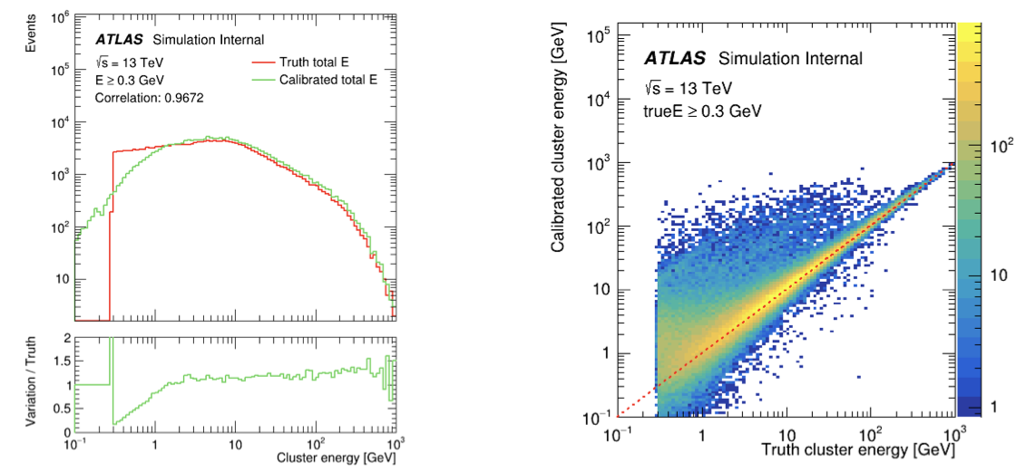
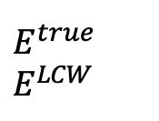
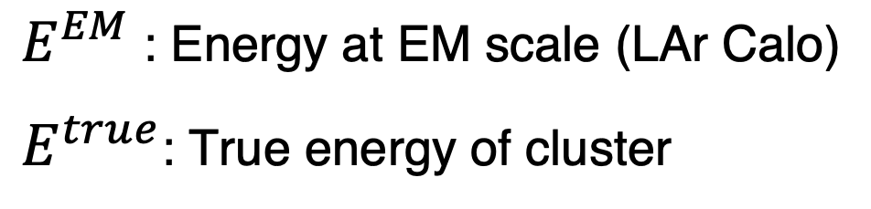
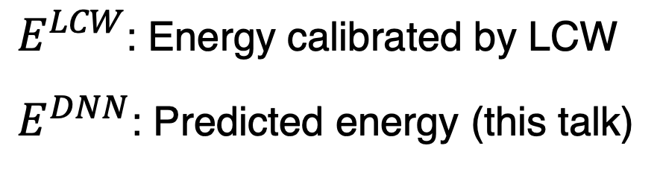
Project goals
                - Determine performance of machine learning model in cluster energy calibration
                - Improve upon LCW calibration of cluster energy, especially at low energies
$$E^{true}$$
$$E^{LCW}$$
                $E^{EM}$ : Energy at EM scale (LAr Calo)
                $E^{true}$: True energy of cluster
                $E^{LCW}$: Energy calibrated by LCW
                $E^{DNN}$: Predicted energy (this talk)

Slide 9


Training
                Deep neural network (DNN)
                - series of layers comprised of nodes, assigning weight factors to inputs in order to provide a prediction
                - Input features include pileup conditions and cluster kinematics, moments, and positions in the detector videos.cern.ch/record/2297341
                - Tune various functions and model parameters
                - May introduce bias due to training on preprocessed features
cluster features
target
$$ℛ^{EM}=\frac{E^{EM}}{E^{truth}}$$
training/testing
prediction
$$E^{DNN}=\frac{E^{EM}}{ℛ^{DNN}}$$

Slide 10
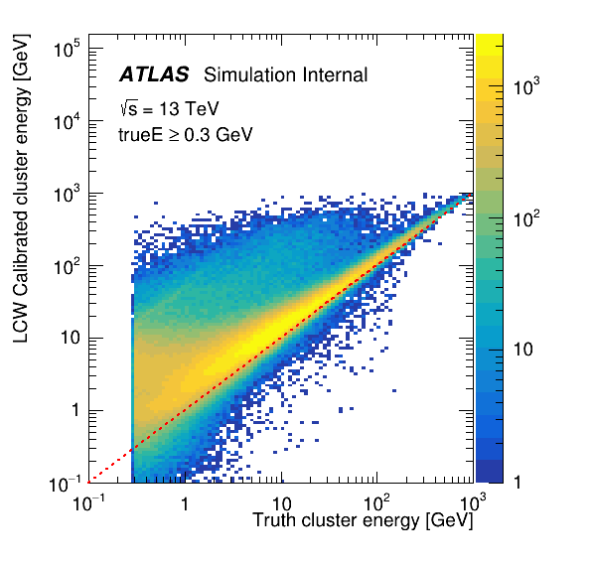
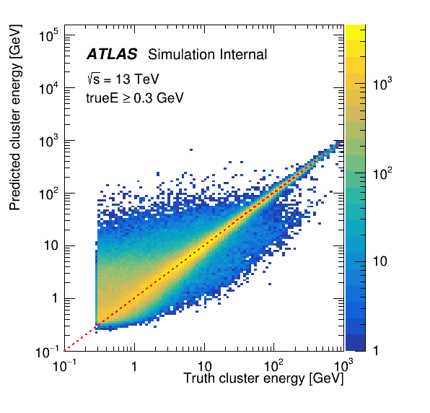
Results
                - Predicted cluster energies perform better than those of LCW
                - Some clusters at higher energies have shifted towards smaller responses

Slide 11
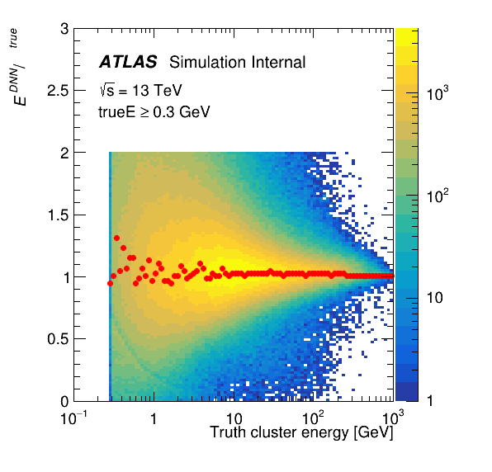
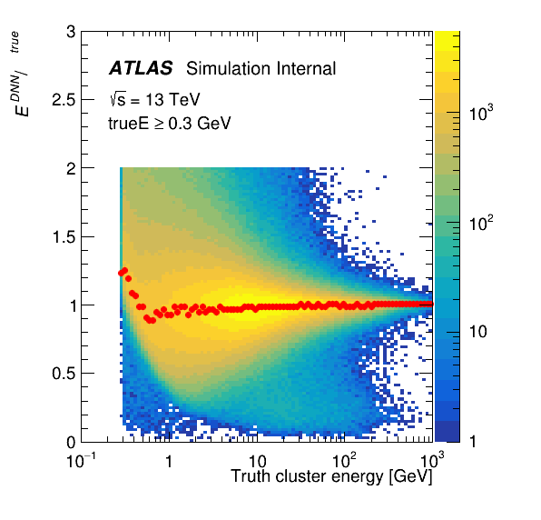
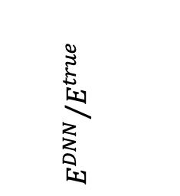

Results: Model adjustments
$${E^{LCW}}/{E^{true}}$$
$${E^{DNN}}/{E^{true}}$$
                - Predicted cluster energies perform better than those of LCW
                - Some clusters at higher energies have shifted towards smaller responses

Slide 12
Results: Model adjustments
$${E^{LCW}}/{E^{true}}$$
$${E^{DNN}}/{E^{true}}$$
                - Predicted cluster energies perform better than those of LCW
                - Some clusters at higher energies have shifted towards smaller responses

Slide 13
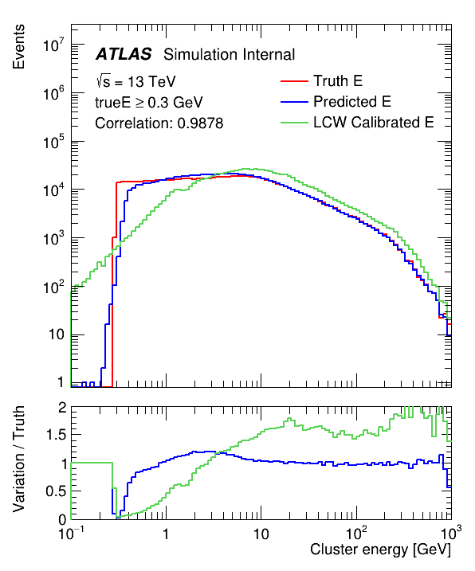
Conclusions
                - ML approach performs well in the low energy spectrum compared to LCW
                - ML optimization is undergoing (features, architecture, hyper-parameters) in addition to understanding the research’s contribution to physics
                - Looking to publish ATLAS internal note

Slide 14
Acknowledgements
                Thank you to Michelle Coe and the Arizona Space Grant team, as well as ATLAS contributors and the UArizona Physics Department for all your support.
                Many thanks to my advisor, Dr. Ken Johns, and the rest of my research group, Jad Sardain, Dr. Peter Loch, and Adnan Alramadan. I’ve been flattered to work on this project and I am excited to see how it develops.
                Thank you also to my family for all the work you have done to get me here.

Slide 15
Acknowledgements
                Thank you!
qpitclo@physics.arizona.edu

Slide 16
Backup

Slide 17
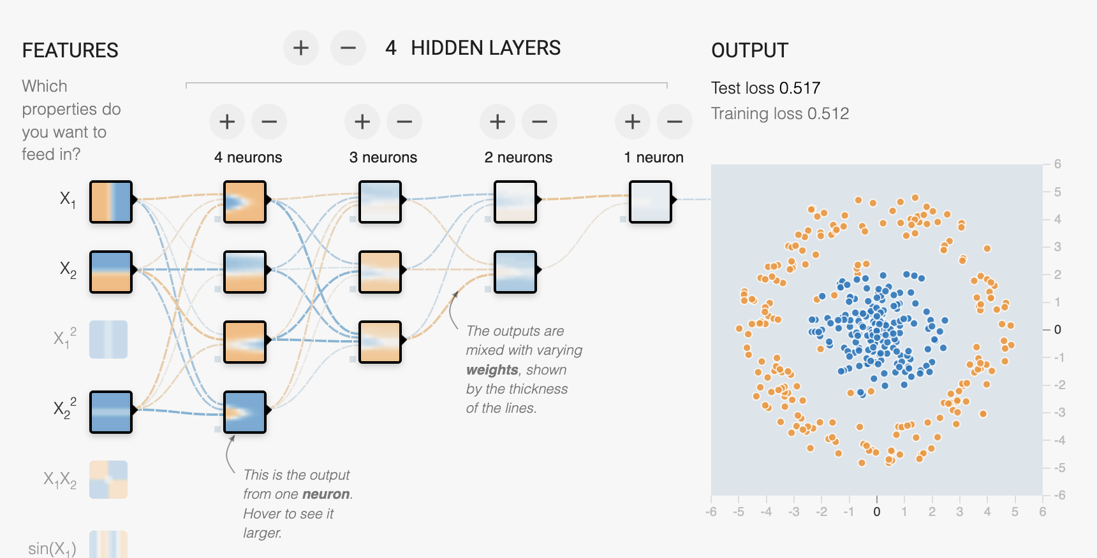
Deep neural network (DNN) architecture
Input visual of old network representation
                Source: playground.tensorflow.org
                weights
                number of neurons/nodes

Slide 18
Deep neural network (DNN) architecture
Layer 1
256 nodes, act = swish
Layer 2
128 nodes, act = swish
Layer 3
64 nodes, act = swish
Layer 4
8 nodes, act = swish
Final layer
1 node, act = C * [tanh(x) + 1]
                - 5 layers, 4 of which are hidden
                - Decreasing number of nodes
                - Use swish activation function for all hidden layers videos.cern.ch/record/2297341
                - Use C*(tanh+1) activation function for final layer
                ** Switched from mean absolute error loss function to the leaky Gaussian kernel loss function (LGK) arXiv:1910.03773v3 [physics.data-an]
Input visual of old network representation

Slide 19
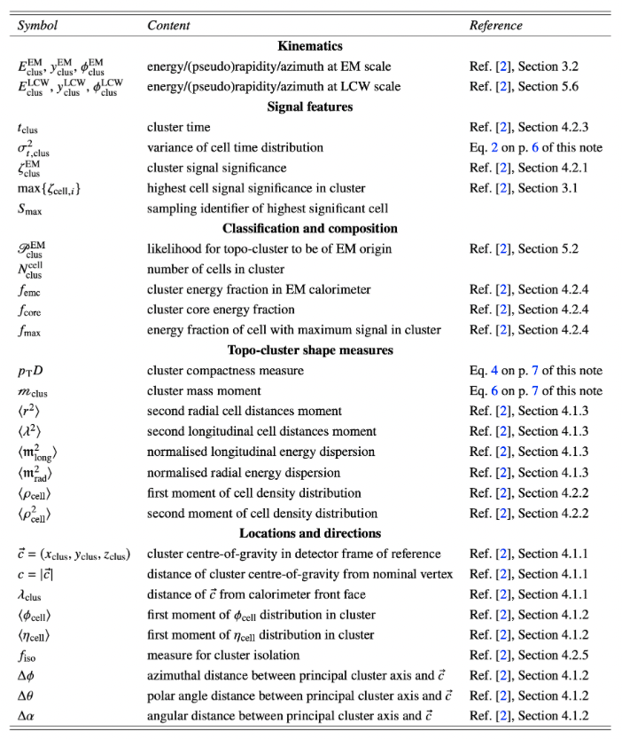
Different features

Slide 20

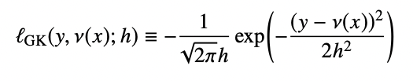
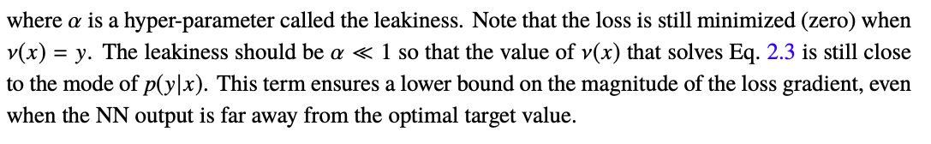
Leaky gaussian kernel loss
                From arXiv:1910.03773v3 [physics.data-an]

